Slide 1
Patrol Supplier Schedule
DBC- Planning
Now
No. | Content | PIC | Feb |  |  |  | Mar |  |  |  | Apr |  |  |  | May |  |  |  | Jun |  |  |  | Remark
 |  |  | 1w | 2w | 3w | 4w | 1w | 2w | 3w | 4w | 1w | 2w | 3w | 4w | 1w | 2w | 3w | 4w | 1w | 2w | 3w | 4w
1 | List check items point | Ms.Sikharin Agm
2 | Setting Organization team Patrol | Ms.Sikharin Agm
3 | Training member | Ms.Sikhain Agm
4 | Supplier information | Ms.Arporn Amgr
5 | Supplier patrol -1 1.SHIN HEUNG 2.MITSUWA KORAT | All
6 | Problem report -1 | Ms.Phornsiri
7 | Supplier patrol -2 1.TRIO 2.KORAT MATSUSHITA
8 | Supplier patrol -3 1.TAPACO KABINBURI
9 | Problem report -2 | Ms.Sikharin
10 | Progressive follow up | Ms.Sikharin
11 | Summary report | Ms.Sikharin
SHIN HEUNG
MITSUWA KORAT
TRIO
KORAT MATSUSHITA
TAPACO

Slide 2
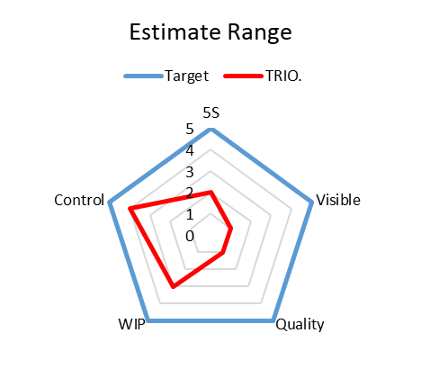
Topic Evaluation
1) 5S
2) Visible
- Production Area
- QC Process
- Finished Product & Shipping Area
3) Quality Control
4) Stock Control
5) Package Control
Evaluation Result
- TRIO
☺
Supplier | Part (items) | Std. WIP of Box (Pcs). | Actual Box support (Pcs.) | Diff
TRIO | 156 | 19,895 | 56,680 | 36,785

Slide 3
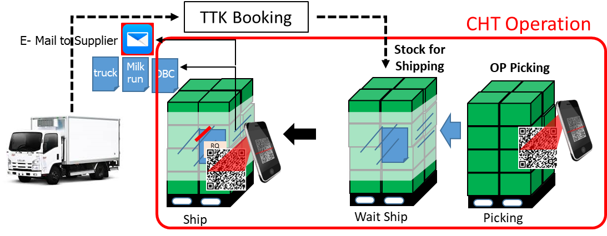
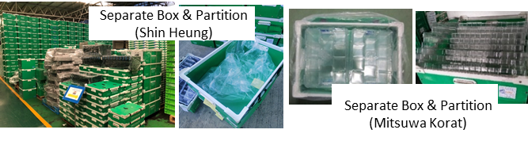
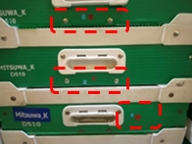
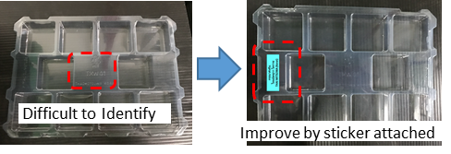
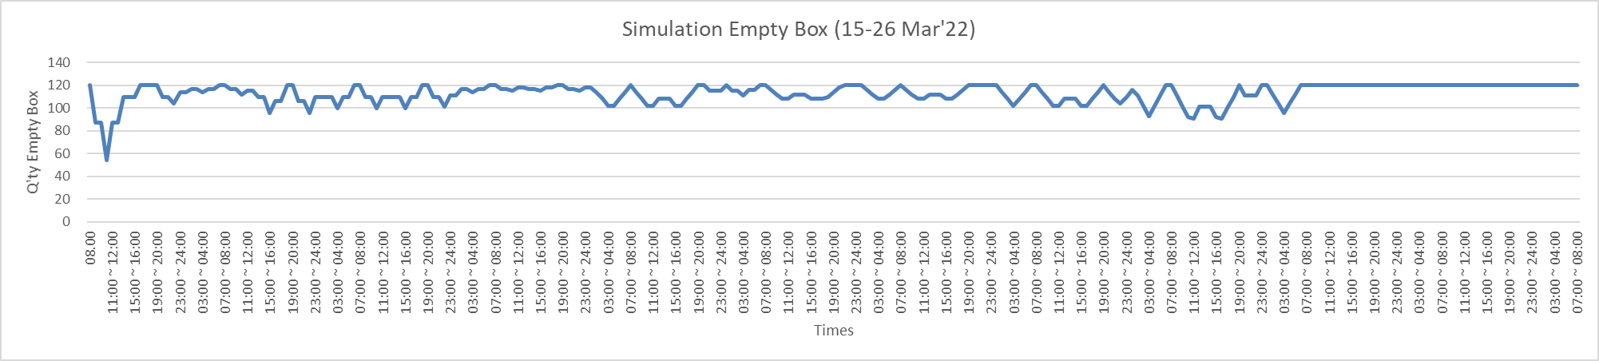
Summary Patrol Check Supplier TRIO
Supplier |  | Problem | Countermeasure
 |  | Use more times to sorting empty box | Attached QR Code (Box code & Partition code) on Box to suitable for sorting Step 1 ; Addition check point by leader Step 2 ; Expand to use QR Code
 |  | Q’ty of Empty Box & Partition are un-match | Assy Box & Partition then delivery to supplier Attached sticker to classify box & partition
 |  | Empty box return un-match with their production plan | Analyze Q’ty of box (wip) and delivery cycle that suitable or not?
Remark : Supplier S=Shin Heung, M=Mitsuwa Korat
Symbol detail ;
X : High impact Supplier
❐ : Middle impact Supplier
- : No impact Supplier

Slide 4
Supplier |  | Problem | Countermeasure
S | M
X  | ❐  | Use more times to sorting empty box Empty box return mistake supplier | Attached QR Code (Box code & Partition code) on Box to suitable for sorting Step 1 ; Addition check point by leader Step 2 ; Expand to use QR Code month AGUST.
❐ | ❐ | Q’ty of Empty Box & Partition are un-match | Assy Box & Partition then delivery to supplier Attached sticker to classify box & partition
X | - | Empty box return un-match with their production plan | Analyze Q’ty of box (wip) and delivery cycle that suitable or not?

Slide 5
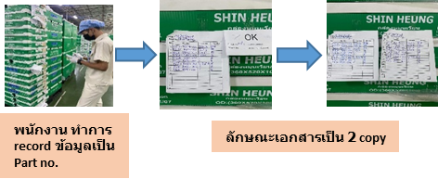
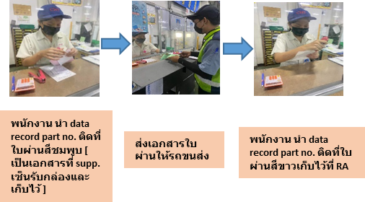
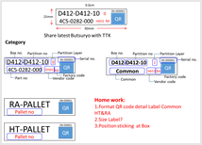
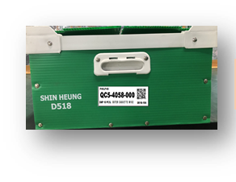




Summary Problem Solving with supplier Shin Heung
No | Problem | Countermeasure | Target | EVA
1 | Parts delayed delivery cause from circulate box un-match with supplier need | Temporary ; DBC Planning support by addition process record box & partition code and sent to supplier when we return empty box for support their operation control Permanent ; Implement QR Code for scanning | 30-Mar-22 (Done) Jun’22 (under preparation)
2 | Quick Cooperation (CHT-Supplier) | CHT member visit supplier for genba check from 31-Mar-22 to 9-Apr-22 (Member : DBC Planning & Procurement) | 31-Mar-22 to 9-Apr-22
3 | Q’ty of Box & Partition are un-match | CHT plan to summary after Tanaoroshi on 18-Apr-22 & also will calculate base on PS of Apr’22 | 25-Apr-22
Remark : - We visit s/p only 31-Mar & 1-Apr due to covid 19 situation at supplier
- On 31-Mar , PO was delayed 95 items which cause from package only 1 items
- On 1-Apr, PO was delayed 200 items which cause from package only 2 items
Symbol :
Finished
On plan
Problem but have countermeasure
x
Problem with no have countermeasure

